Slide 1
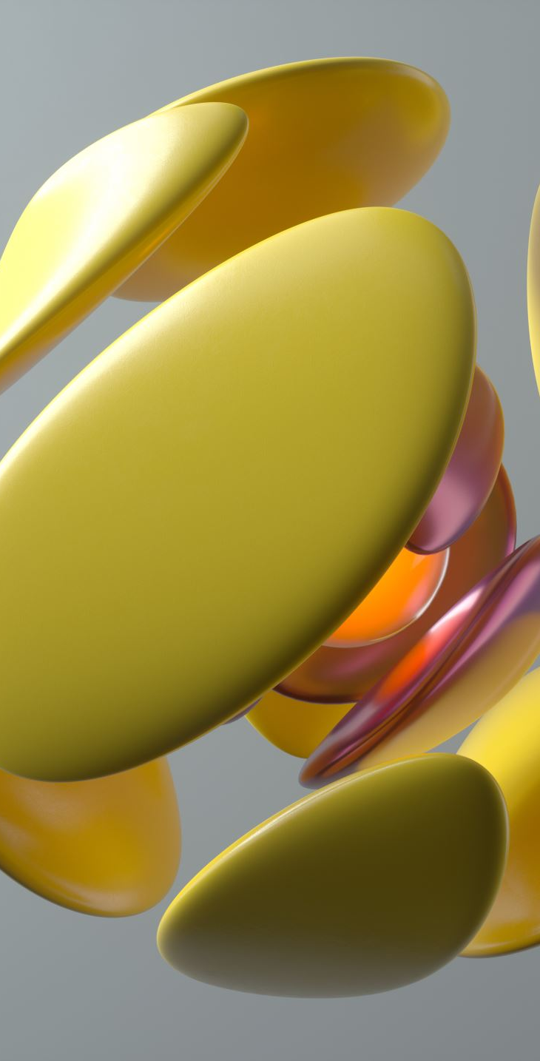
The DNA of Design
Elements of Design – Building Blocks of Visual Communication
Notes:
Elements of Design – Building Blocks of Visual Communication
Welcome students warmly. “Good morning everyone, and welcome back. Today we’re starting with the foundations of design—what we call the Elements of Design.”
Frame the session. “Think of today as learning the ingredients of all design. Just like you can’t cook without ingredients, you can’t create effective visual communication without these elements.”
Motivate them. “By the end of today, you’ll start to see these elements everywhere—on posters, in apps, in packaging, even in social media graphics. You’ll notice design differently, and that awareness will make you stronger designers.”

Slide 2
Why Do We Design?
Communication
Clarity
Persuasion
Emotion
Notes:
Design isn’t just about making something look pretty—it’s about solving problems.
We design to communicate—to deliver information clearly and effectively.
We design for clarity—think about a menu that’s easy to read versus one that’s cluttered and overwhelming.
We design to persuade—ads don’t just show a product, they make you want it.
And we design to create emotion—a movie poster should make you excited, a charity campaign should move you to care.
Tie-in example: Show a bad sign/menu that’s confusing, then show a clean, effective one. Ask students: Which would you rather use? Why?

Slide 3
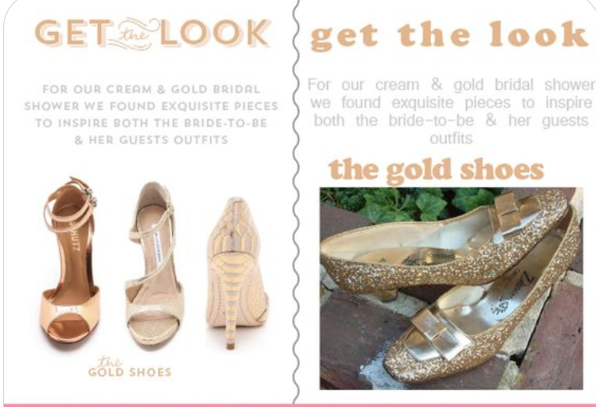
Notes:
Communication
Combining an image, a headline, and a paragraph can look quite easy, but in this example, we see two versions of the same idea with different approaches.
On the left side, we see a stylized caption, a well-crafted paragraph, and an image with shoes on transparent background.
On the right, we see the same text, with a different visualized headline that is fighting with the image title, different font for the paragraph that is harder to read, and a different image of shoes.
Which version do you like more?
Image and copy from 14 Really Bad Graphic Design Examples [& How To Fix Them] – RGD
https://reallygooddesigns.com/bad-graphic-design/

Slide 4
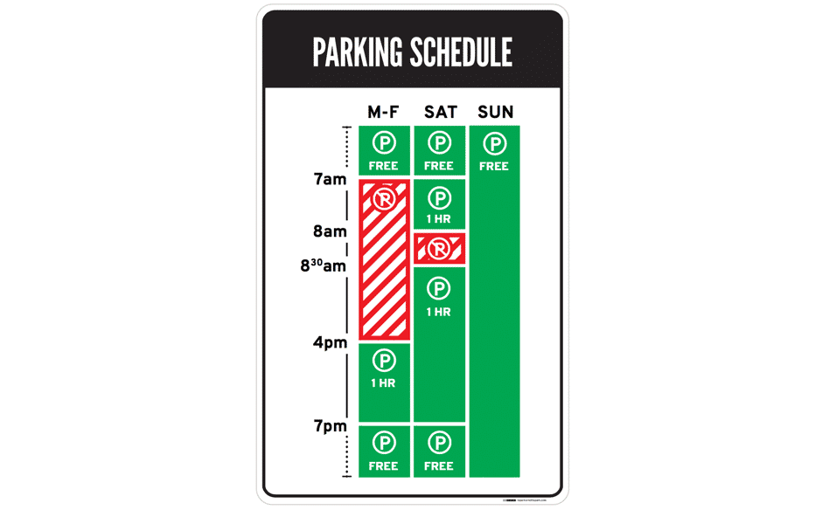
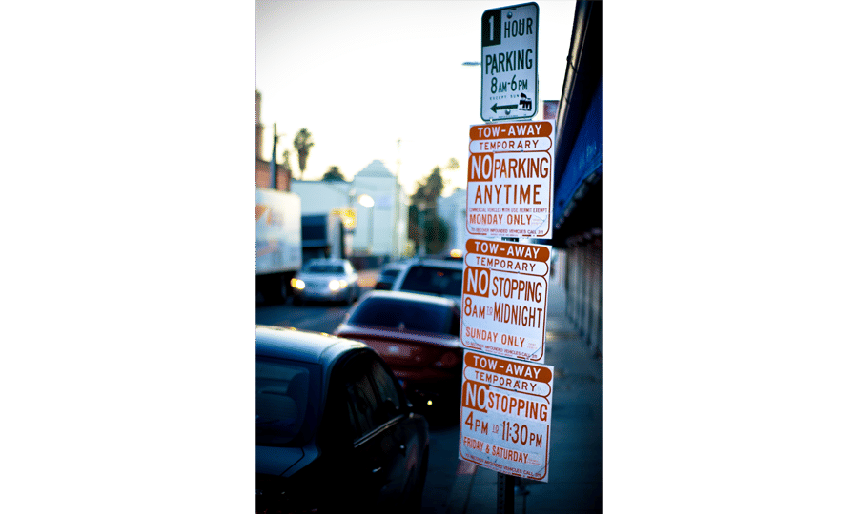
Notes:
CLARITY
Imagine you are a driver along this road on a Tuesday morning at 9 a.m. Can you park at this spot? What sounds like a simple question takes a lot of mental processing to answer.
As designers, we’re often faced with situations where we have to design for a lot of information to be displayed in a small space. The parking signs in LA might be an extreme case, but many times designing for mobile apps means facing the same problems. Is there a way out for both the parking signs and designers in general?
This is GOOD DESIGN
It works well because it’s user-centered. The designer realized that drivers simply want to know whether they can park at a spot. Yes or no—that’s all drivers needed, and that’s all the parking sign shows.
The design uses visuals, rather than text, to convey information. The result is incredibly intuitive—green for OK, red for No Parking. It’s even designed for the colour blind, with stripes for No Parking.
Now when you look at the sign, you’ll know that on Tuesday at 9 a.m., parking is not allowed. The bars show what’s what at a glance—simple.
Images and copy from Bad Design vs. Good Design: 5 Examples We Can Learn From | IxDF
https://www.interaction-design.org/literature/article/bad-design-vs-good-design
Teo, Y. S. (2025, July 21). Bad Design vs. Good Design: 5 Examples We Can Learn From. Interaction Design Foundation - IxDF. https://www.interaction-design.org/literature/article/bad-design-vs-good-design

Slide 5
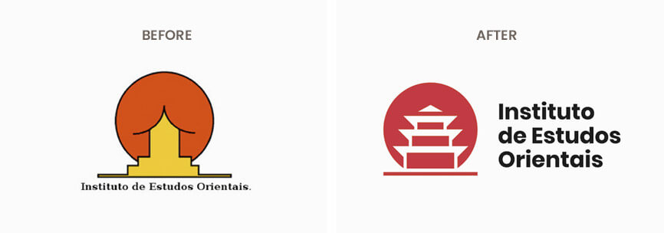
Notes:
EMOTION
Design is all about emotion and feeling – what emotion do you want your audience to feel when looking at your design?
The original logo example(left side) gets you in a completely different mood compared to the alternative version of the logo made by Emanuele Abrate.
Note, that we are talking about the same company. It is amazing how a logo can affect our opinion about a company, right?
Image and copy from 14 Really Bad Graphic Design Examples [& How To Fix Them] – RGD
https://reallygooddesigns.com/bad-graphic-design/

Slide 6
Elements of Design
Line:
Shape:
Direction:
Size:
Texture:
Colour:
A path between two points
A two-dimensional enclosed space
The orientation or movement of elements
The relative scale of elements
The surface quality of an object
The perception of light reflected from surfaces
Notes:
These are the six essential building blocks of visual design.”
Each one might seem simple, but designers use them deliberately to guide attention, create impact, and send messages.”
Think of them like a recipe: today we’ll look at each ingredient, and later in the course, we’ll learn how to combine them with the principles of design—like balance, alignment, and contrast.”
On the next few slides, we’ll dive into each element, one at a time.”

Slide 7
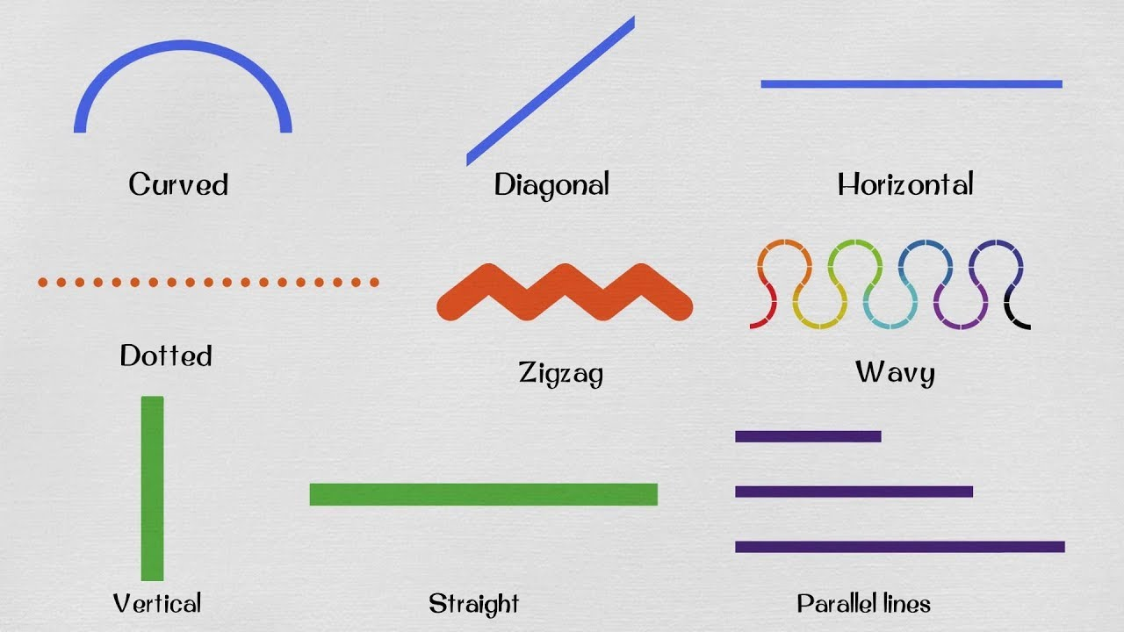
Line
A path between two points; lines can be straight, curved, thick, thin, implied, or literal.
Defines edges
Guides the eye
Creates mood or movement
Notes:
Definition A path between two points; lines can be straight, curved, thick, thin, implied, or literal.
Why it matters
Defines edges
Guides the eye
Creates mood or movement
Lines guide the viewer’s eye. In advertising, a diagonal line may draw attention toward a product, while a horizontal line might create stability.

Slide 8
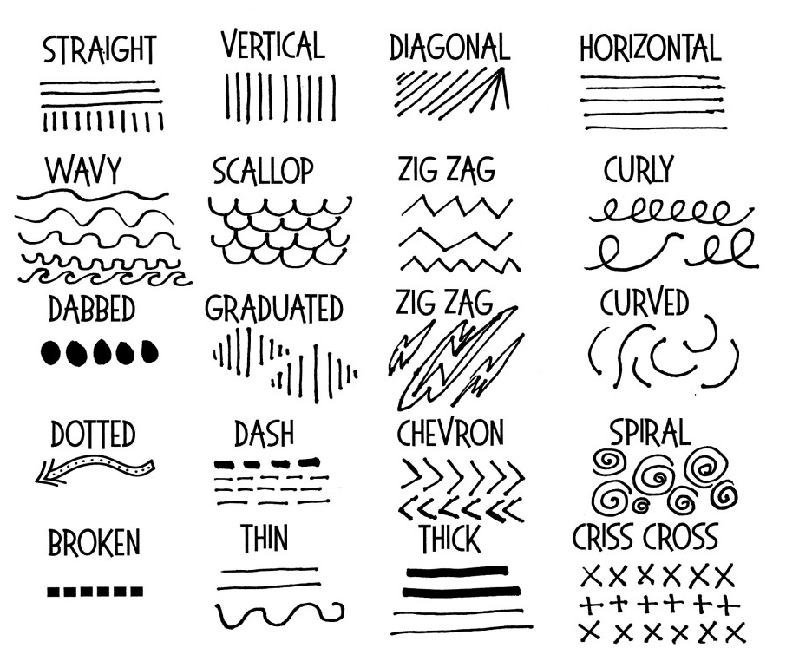
Notes:
Different line qualities change emotional tone:
Thin, delicate lines = elegance, fragility.
Thick, bold lines = strength, confidence.
Curved lines = movement, playfulness, warmth.

Slide 9
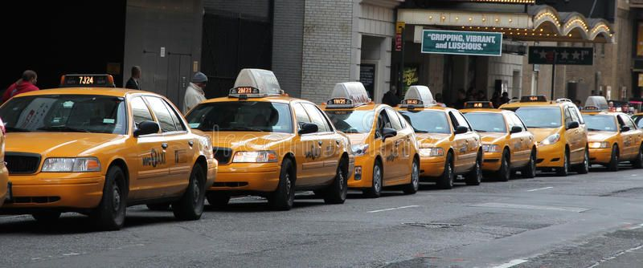

Line - Implied
Notes:
implied lines are also powerful:
A line of taxis
The border between water and sand

Slide 10

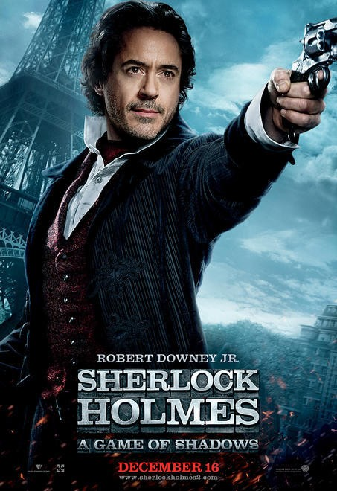
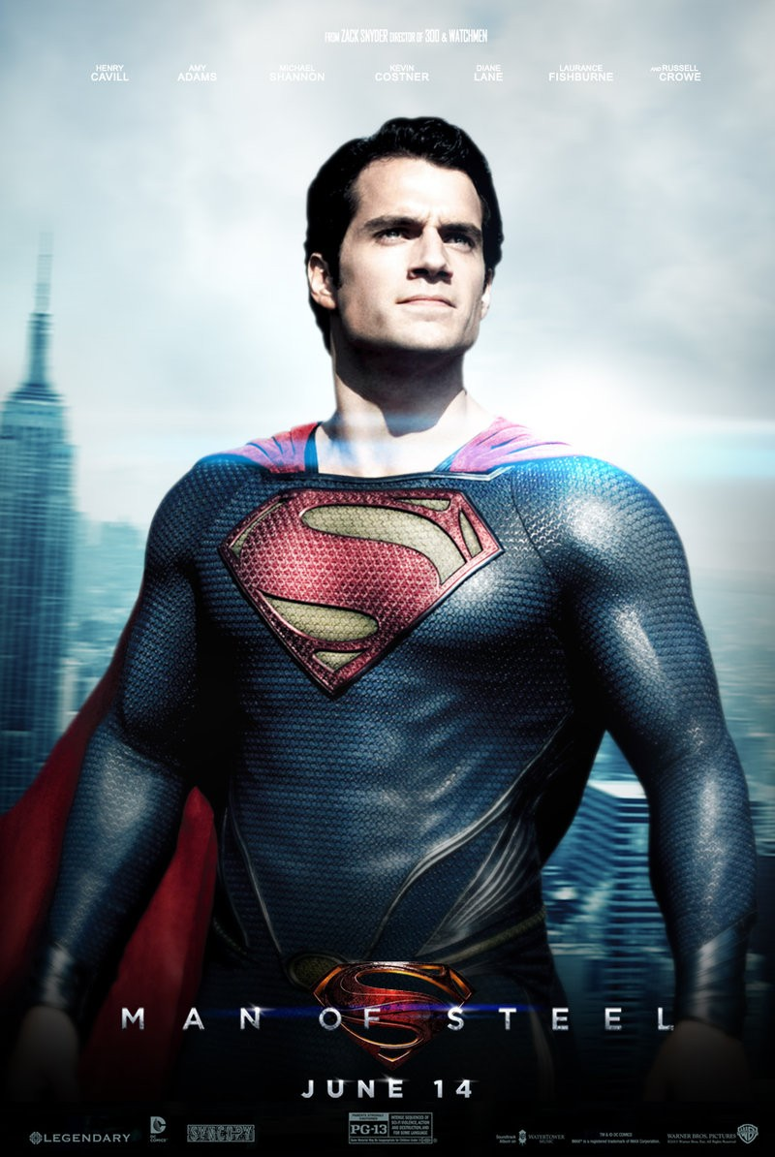
LINE - Psychic
Notes:
for example, a model’s gaze in a fashion ad creates an invisible line that leads your eyes to the product.
Image from You may look like a dad, but we’re going to call you a mom | dadmarketing
https://dadmarketing.com/2016/05/27/you-may-look-like-a-dad-but-were-going-to-call-you-a-mom/

Slide 11

LINE - Example
Notes:
Example to show: Nike ads → bold diagonal lines emphasize motion and energy, reinforcing their “Just Do It” brand.
The line defines the shape
This is also a shape
Image from NIKE, Inc. Logos —
https://about.nike.com/en/newsroom/collections/nike-inc-logos/NIKE-Inc

Slide 12
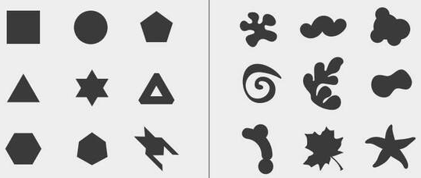
Shape
A two-dimensional enclosed space created by lines, colour, or texture.
Geometric or organic
Defines objects
Creates contrast and unity
Notes:
A two-dimensional enclosed space created by lines, colour, or texture. Shapes can be geometric (squares, circles, triangles) or organic (free-form, natural).
Why it matters:
In graphic design, shape matters because shapes communicate meaning, create visual interest, and guide the viewer's attention. Even before someone reads any text, the shapes in a design influence how they interpret the message.
Image from Shape - Kapunda High Art and Design
https://kapundahigh.weebly.com/shape.html

Slide 13
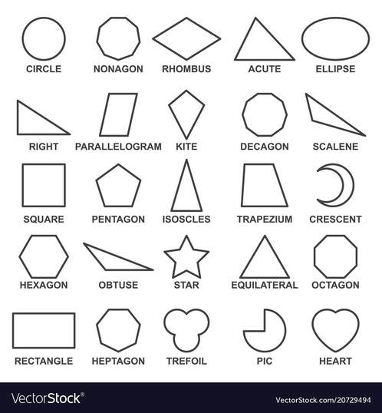
Shape - Geometric
Notes:
Geometric shapes feel modern, structured, and orderly.

Slide 14
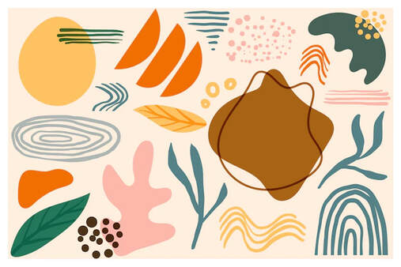
Shape - Organic
Notes:
Organic shapes feel more natural, playful, and approachable.
Organic shapes (free-form, natural shapes) suggest nature, creativity, comfort, and uniqueness.
Image from Shape - Kapunda High Art and Design
https://kapundahigh.weebly.com/shape.html

Slide 15
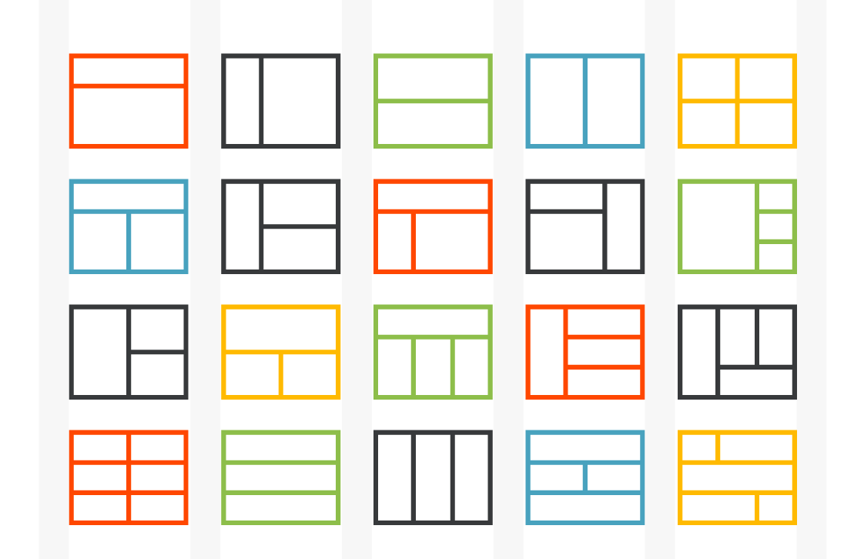
Shape - layouts
Notes:
Combining shapes creates rhythm and visual unity in layouts.
Shapes Organize Information
Shapes can group related content together and separate different pieces of information.
For example:
Boxes can contain related text.
Circles can highlight key statistics.
Background shapes can visually connect images and captions.
This makes designs easier to understand and navigate.

Slide 16
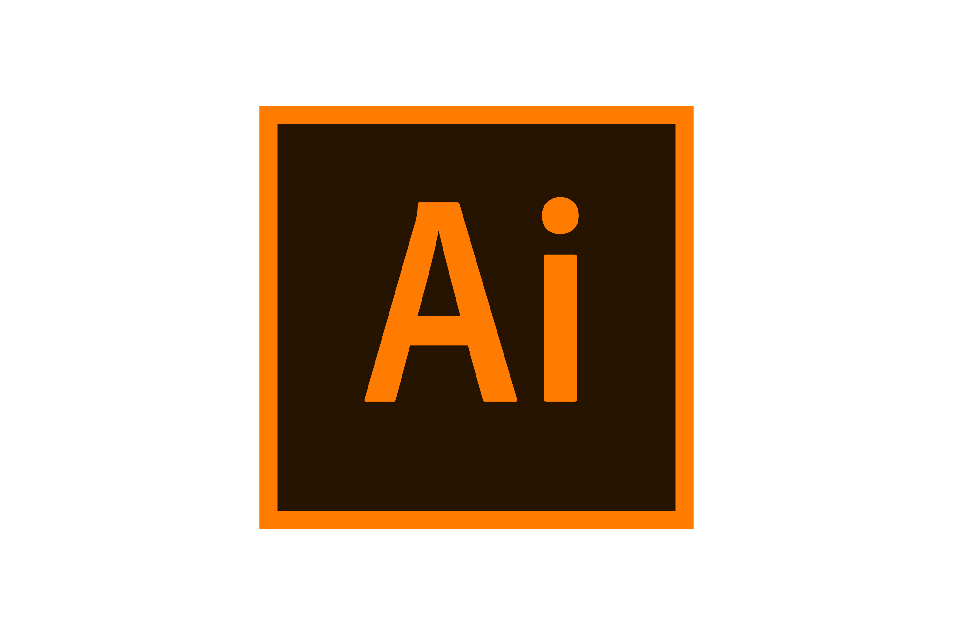

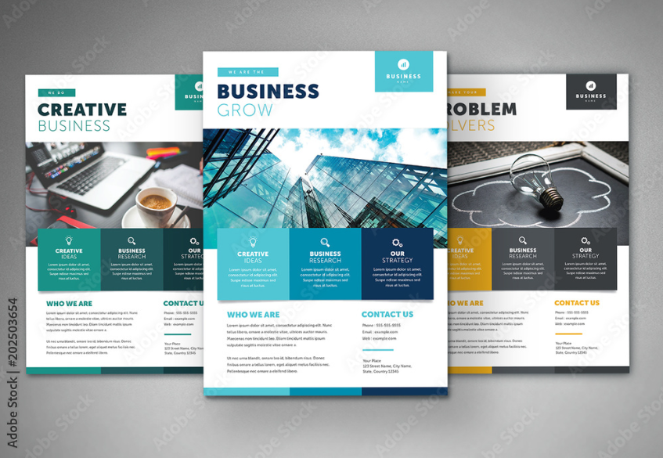
Shape - symbolism
Squares &
Rectangles
Stability
Framing
Importance
Notes:
Shapes also create symbolism: squares suggest stability.
Squares: Stability, framing, and importance.
Squares and rectangles suggest stability, reliability, order, and professionalism.
Information from Psychology of Shapes in Design: A Guide for Visual Storytelling
https://www.dochipo.com/psychology-of-shapes/#:~:text=Different%20shapes%20convey%20different%20meanings,narrative%20of%20significance%20and%20purpose.
Square Images from
Download Adobe Illustrator Logo in SVG Vector or PNG File Format - Logo.wine
https://www.logo.wine/logo/Adobe_Illustrator
Business Flyer Layout with Colorful Squares Stock Template | Adobe Stock
https://stock.adobe.com/ca/templates/business-flyer-layout-with-colorful-squares/202503654
American Express – Wikipedia
https://en.wikipedia.org/wiki/American_Express

Slide 17
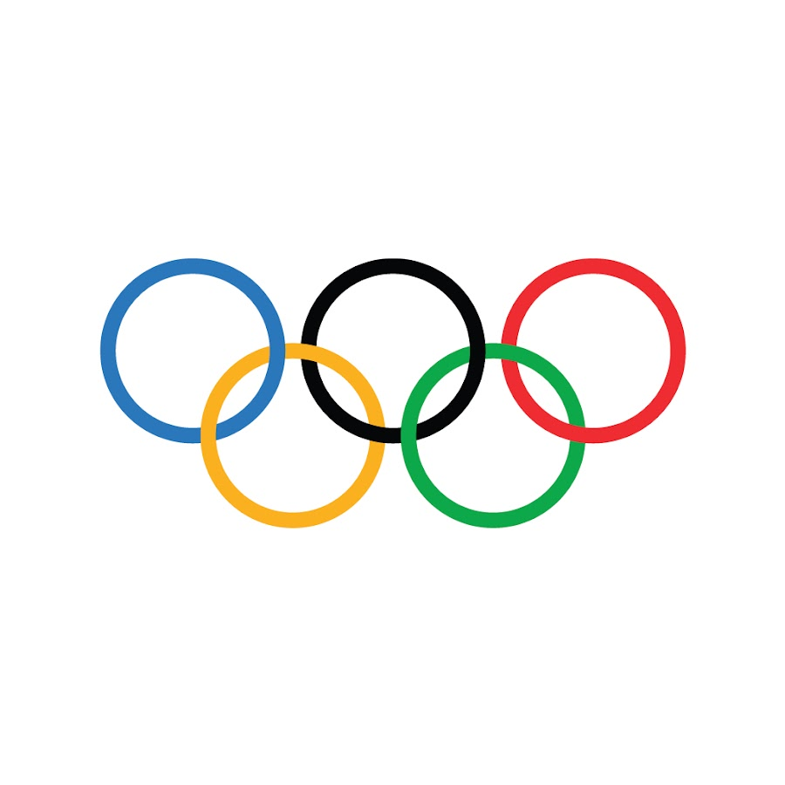
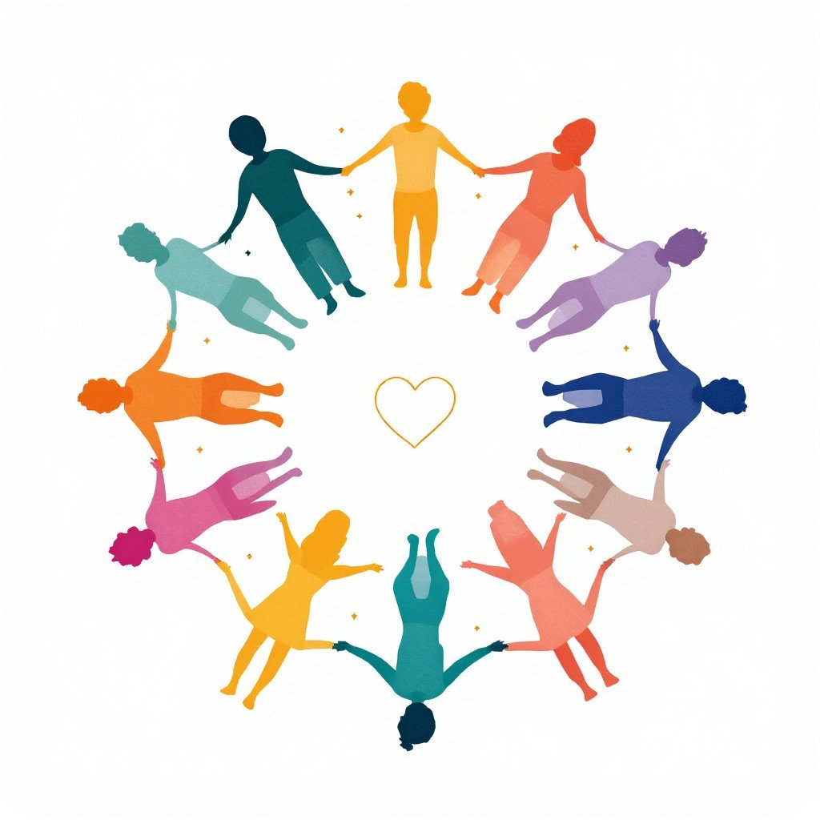
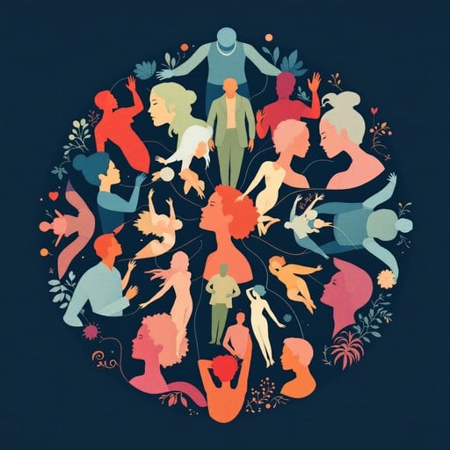
Shape - symbolism
Circle and Ovals
Gentleness
Unity
Balance
Photo by <a href="https://stockcake.com/i/circle-of-togetherness_3059498_1654920">Stockcake</a>
Photo by <a href="https://stockcake.com/i/unity-through-diversity_1629381_1198910">Stockcake</a>
Notes:
Shapes also create symbolism: circles suggest unity.
Circles: Gentleness, unity, and balance.
Circles and ovals suggest unity, community, harmony, movement, and friendliness.
Information from Psychology of Shapes in Design: A Guide for Visual Storytelling
https://www.dochipo.com/psychology-of-shapes/#:~:text=Different%20shapes%20convey%20different%20meanings,narrative%20of%20significance%20and%20purpose.
Circle Images from
Photo by <a href="https://stockcake.com/i/unity-through-diversity_1629381_1198910">Stockcake</a>
Photo by <a href="https://stockcake.com/i/circle-of-togetherness_3059498_1654920">Stockcake</a>
https://www.youtube.com/olympics

Slide 18

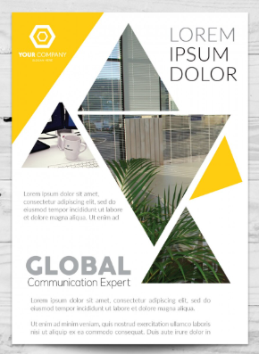
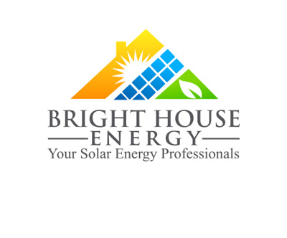
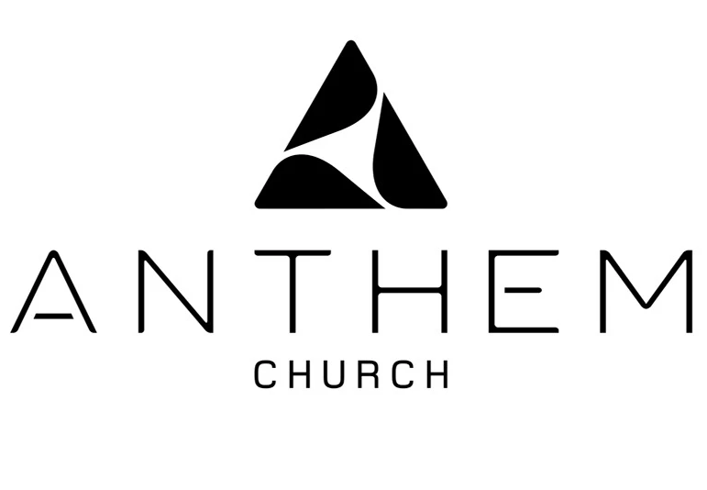
Shape - symbolism
Triangles
Stability
Power
Energy
Adidas Logo and symbol, meaning, history, PNG, brand
Notes:
Triangles: Stability, power, and energy.
Triangles suggest direction, energy, action, growth, or tension.
PLUS MANY MORE – see link on BRIGHTSPACE
Parallelograms: Dynamic, harmonious, and balanced.
Trapeziums: Stability, movement, and modernity.
Rhombus: Luxury, sophistication, and abstract style.
Pentagons: Protection, unity, and five elements.
Hexagons: Communication, balance, and trust.
Geometric Lines: Structure, order, and visual hierarchy.
Fluid Lines: Movement and energy.
Flowing Curves: Continuity, grace, and elegance.
Creative Splotches: Spontaneity and unpredictability.
Organic Icons: Connection with nature and growth.
Abstract Shapes: Curiosity, emotions, and storytelling.
Information from Psychology of Shapes in Design: A Guide for Visual Storytelling
https://www.dochipo.com/psychology-of-shapes/#:~:text=Different%20shapes%20convey%20different%20meanings,narrative%20of%20significance%20and%20purpose.
Triangle Images from
ANTHEM Church | Rebrand :: Behance
https://www.behance.net/gallery/11080707/ANTHEM-Church-Rebrand
Triangle Logos Explore Science of Shapes in Branding – ZillionDesigns
https://www.zilliondesigns.com/blog/triangle-logos-science-shapes-branding/
Adidas Logo and symbol, meaning, history, PNG, brand
https://1000logos.net/adidas-logo/
Business flyer triangle design | Free Vector
https://www.freepik.com/free-vector/business-flyer-triangle-design_1155077.htm

Slide 19
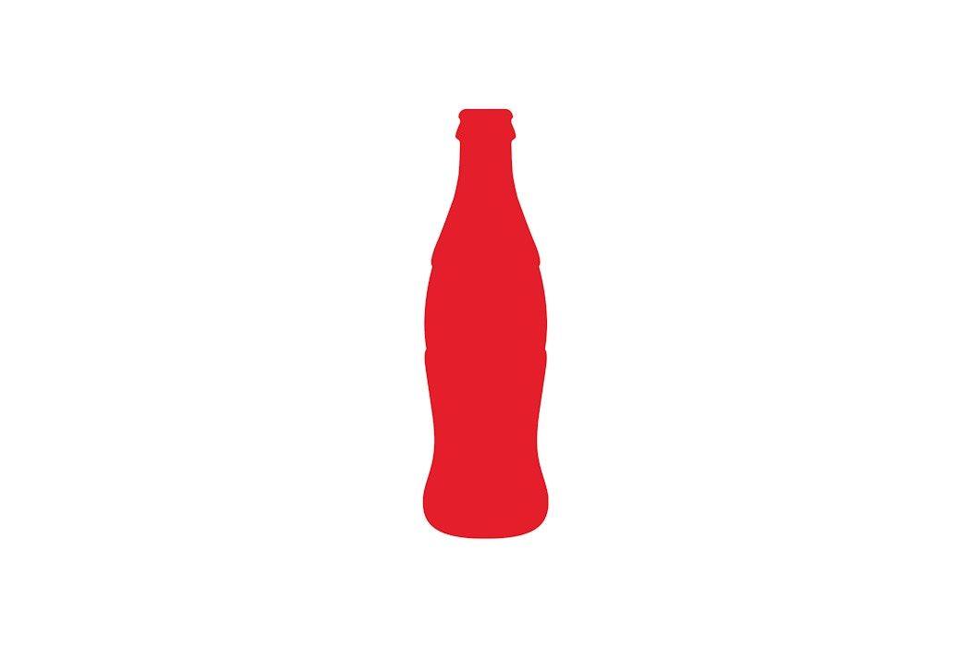
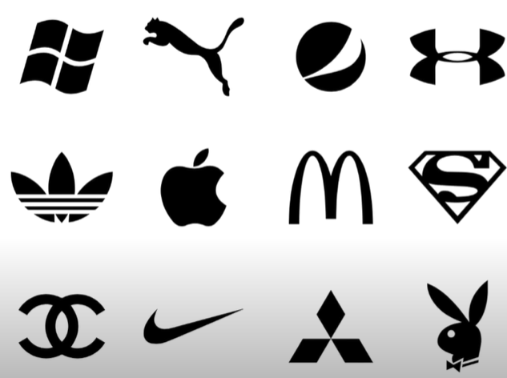
Shape - Recognition
Notes:
Shapes build recognition and identity. Think of the red circle of the Target logo—simple, geometric, and instantly recognizable.
Example to show: Coca-Cola bottle silhouette—an iconic organic shape that became part of its brand identity.
Image from Graphic Design for Beginners - Working with Shapes
https://www.youtube.com/watch?v=8PWXjh0dzZ8&list=PLdJFWTlhZvaOkoiPO3DDLAsRV2004tDZG&t=1s

Slide 20
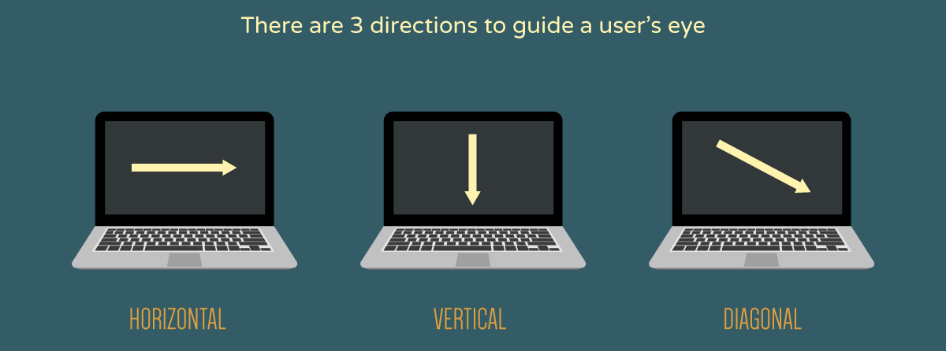
Direction
The orientation or movement of elements within a design (horizontal, vertical, diagonal, or implied).
Creates movement
Leads the eye
Suggests emotion or action
Notes:
Definition (Slide Copy): The orientation or movement of elements within a design (horizontal, vertical, diagonal, or implied).
Why it matters (Speaker Notes):
Image from
Direction - An important part of Web Design | Infographic - InkHive.com
https://inkhive.com/2018/03/25/direction-important-part-web-design-infographic/

Slide 21
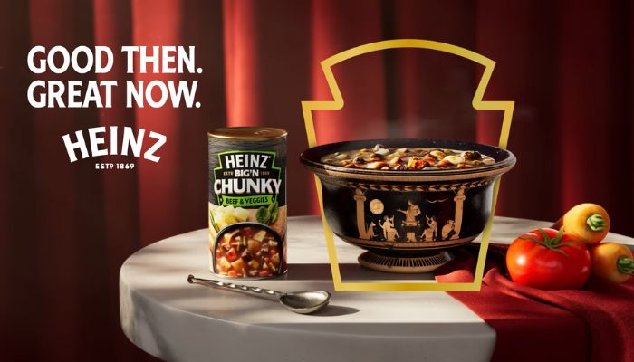

Direction - Horizontal
Notes:
Direction creates movement and tells the viewer how to read the page.
Horizontal direction = calm, stability (think of landscape photos).
Left to Right
Some cultures it is right to left
Images from
Daytona Beach vacations ad ideas turn off tourism leaders
https://www.news-journalonline.com/story/news/2022/02/10/daytona-beach-vacations-ad-ideas-turn-off-tourism-leaders/6707421001/
Heinz spotlights ancient origins of ‘soup’ and how it’s able to make the classic meal ‘great now’ in new ad - MARKETECH APAC
https://marketech-apac.com/heinz-spotlights-ancient-origins-of-soup-and-how-its-able-to-make-the-classic-meal-great-now-in-new-ad/

Slide 22
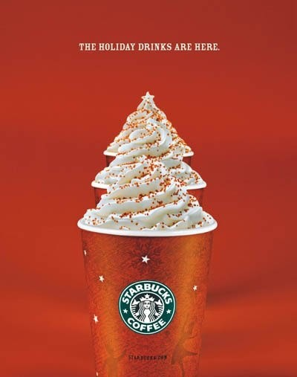
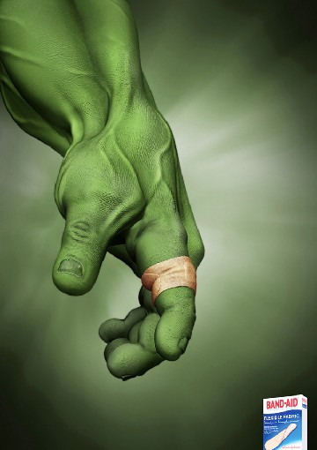
Direction - Vertical
Notes:
Vertical direction = strength, authority (think of skyscraper ads or luxury branding).
Bottom up
Top down

Slide 23
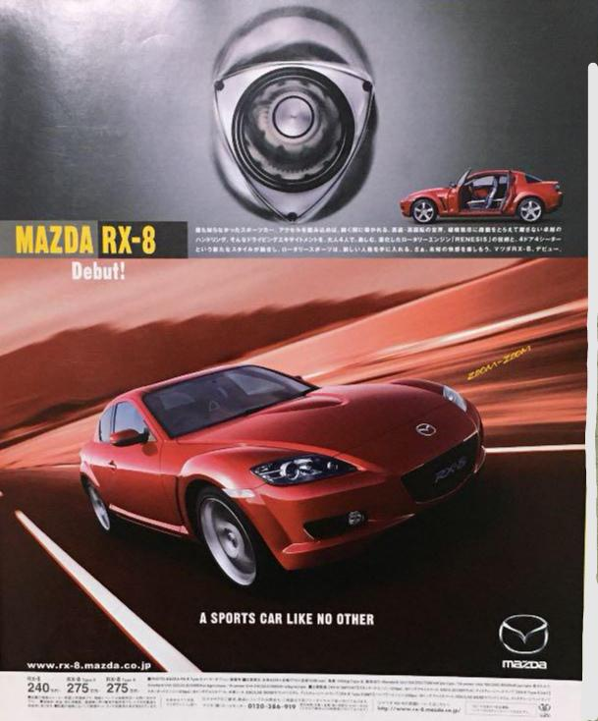
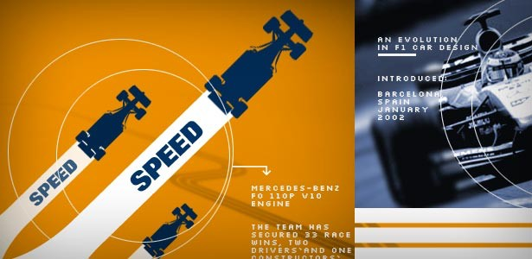
Direction - Diagonal
Notes:
Diagonal direction = dynamism, motion, tension—very common in sports design.
Images from
Mazda RX8 Ad, 2003, Japan. : r/mazda
https://www.reddit.com/r/mazda/comments/l7018p/mazda_rx8_ad_2003_japan/#lightbox

Slide 24

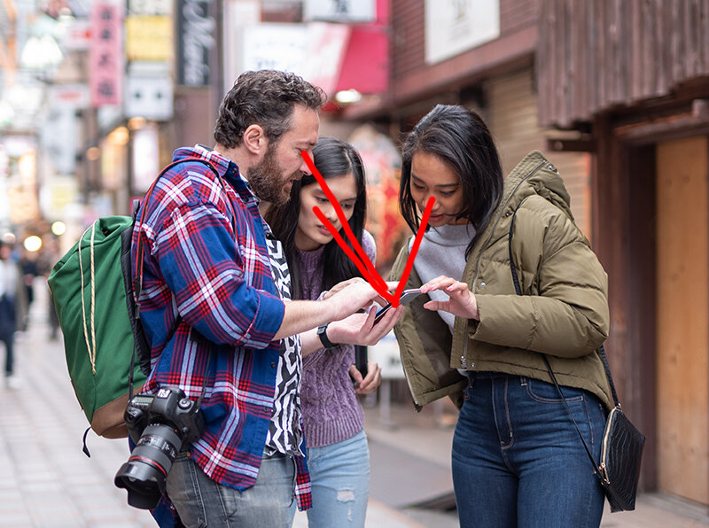
Direction - implied
Notes:
Implied direction: placement of objects or figures leading your eye across the page.
Example to show: Car ads often use diagonal orientation to emphasize speed and energy.
Images from
Implied lines and their role in photographic composition — A Year With My Camera
https://ayearwithmycamera.com/blog/implied-lines-and-their-role-in-photographic-composition
Papia: Diaper • Ads of the World™ | Part of The Clio Network
https://www.adsoftheworld.com/campaigns/diaper-447d0060-2982-45dd-9882-d8e1b8620bba

Slide 25
Finding Elements of DesigN
In-Class Assignment: DUE by the end of class

